Slide 1
Ver 14 production issues

Slide 2
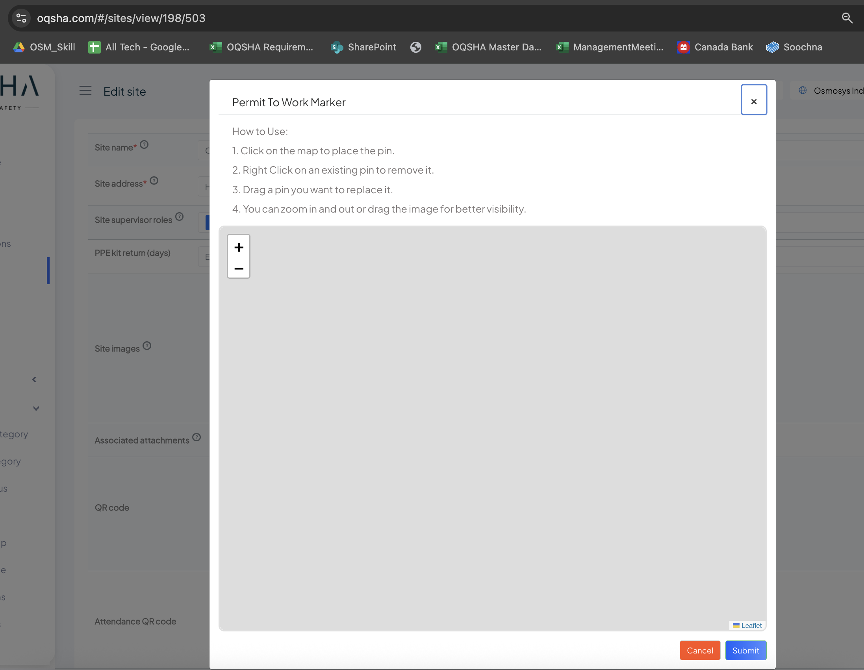
NO Buttons work in this page.
But what is the purpose of this?
I added some random image and then this appears when I click it

Slide 3
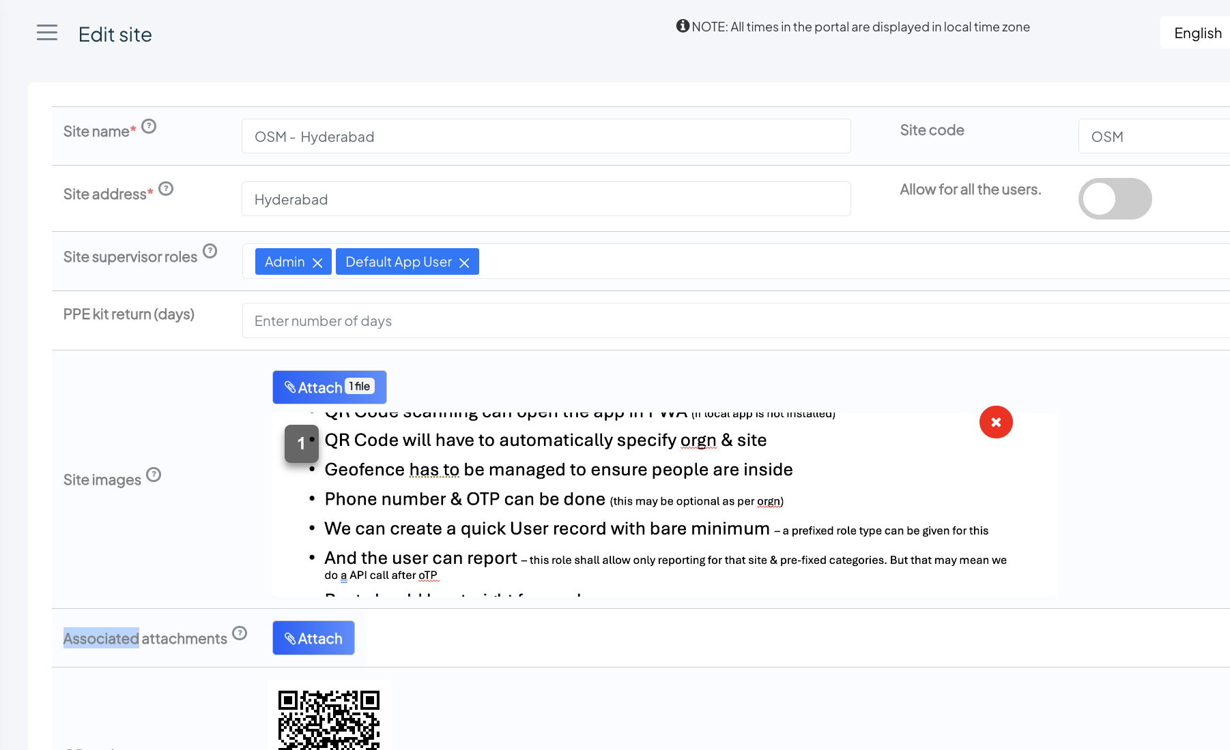
The RED color X is not working

Slide 4
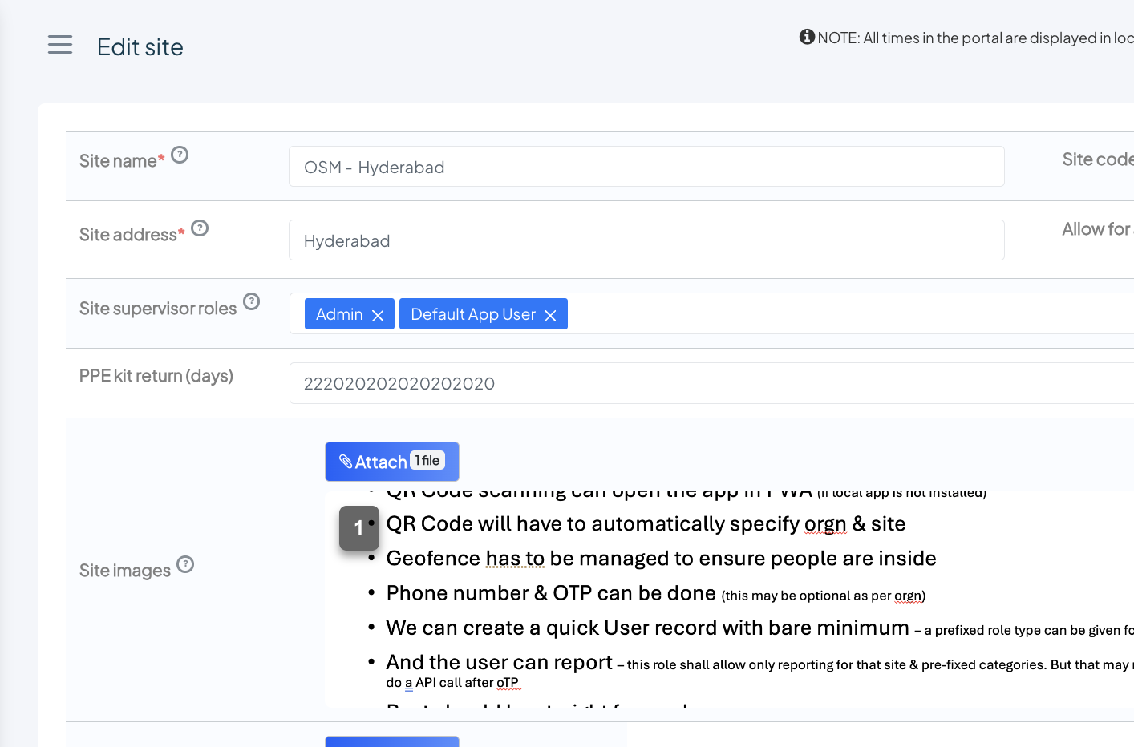
Can the “programmer that added the PPE Kit return days” tell me how many years is that value entered there?
Who is this GENIUS?

Slide 5
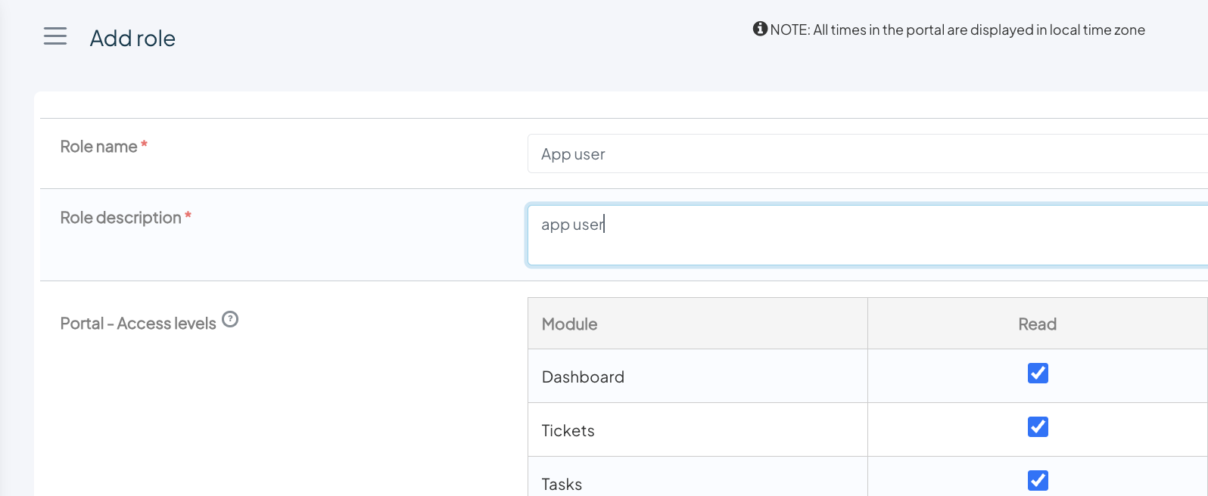
Role description need not be mandatory

Slide 6
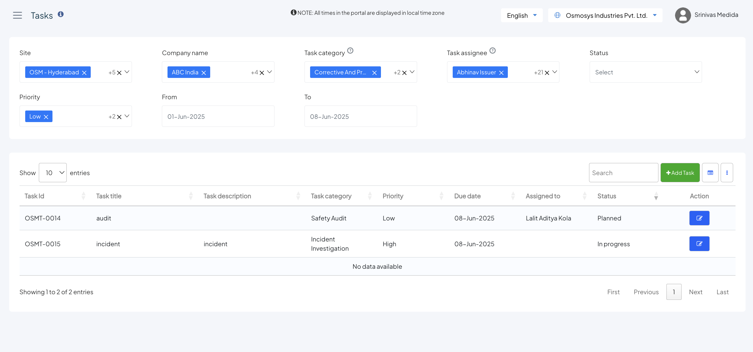
Sorting is NOT working on Assigned

Slide 7
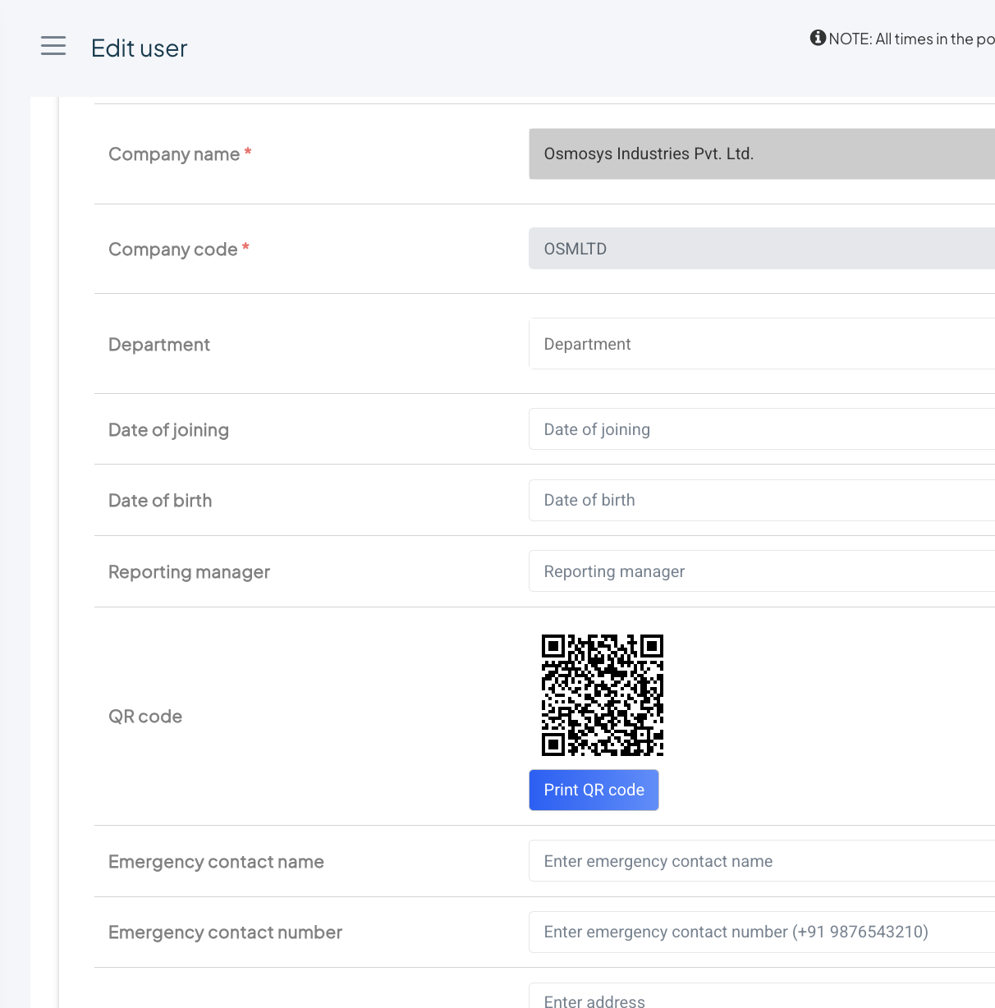
In user – what is this QR code for?
If it is printed – will the app scan and work?

Slide 8
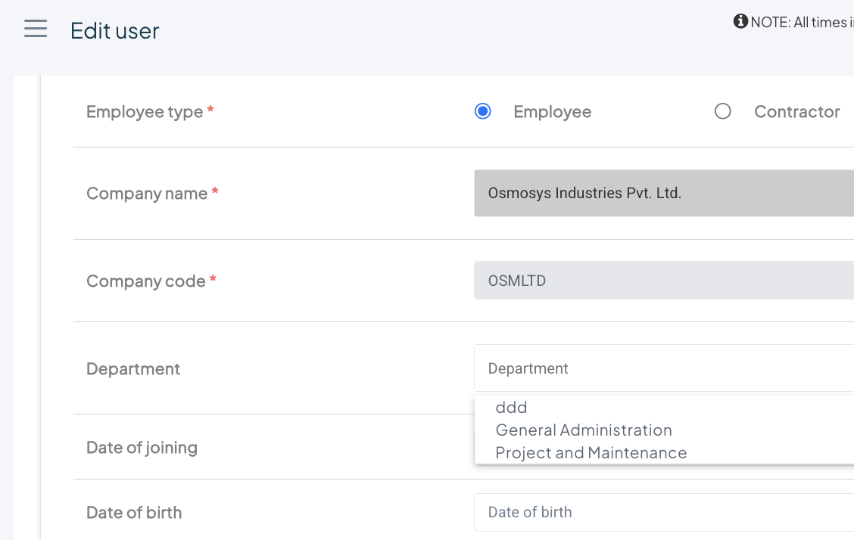
This dropdown is not looking good but if this is going to change after department menu item comes, its ok

Slide 9
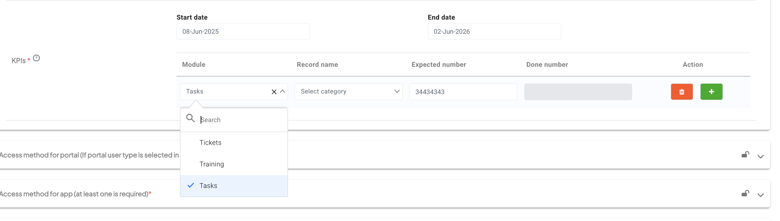
We should add more modules here
And the expected number – again no limit?

Slide 10
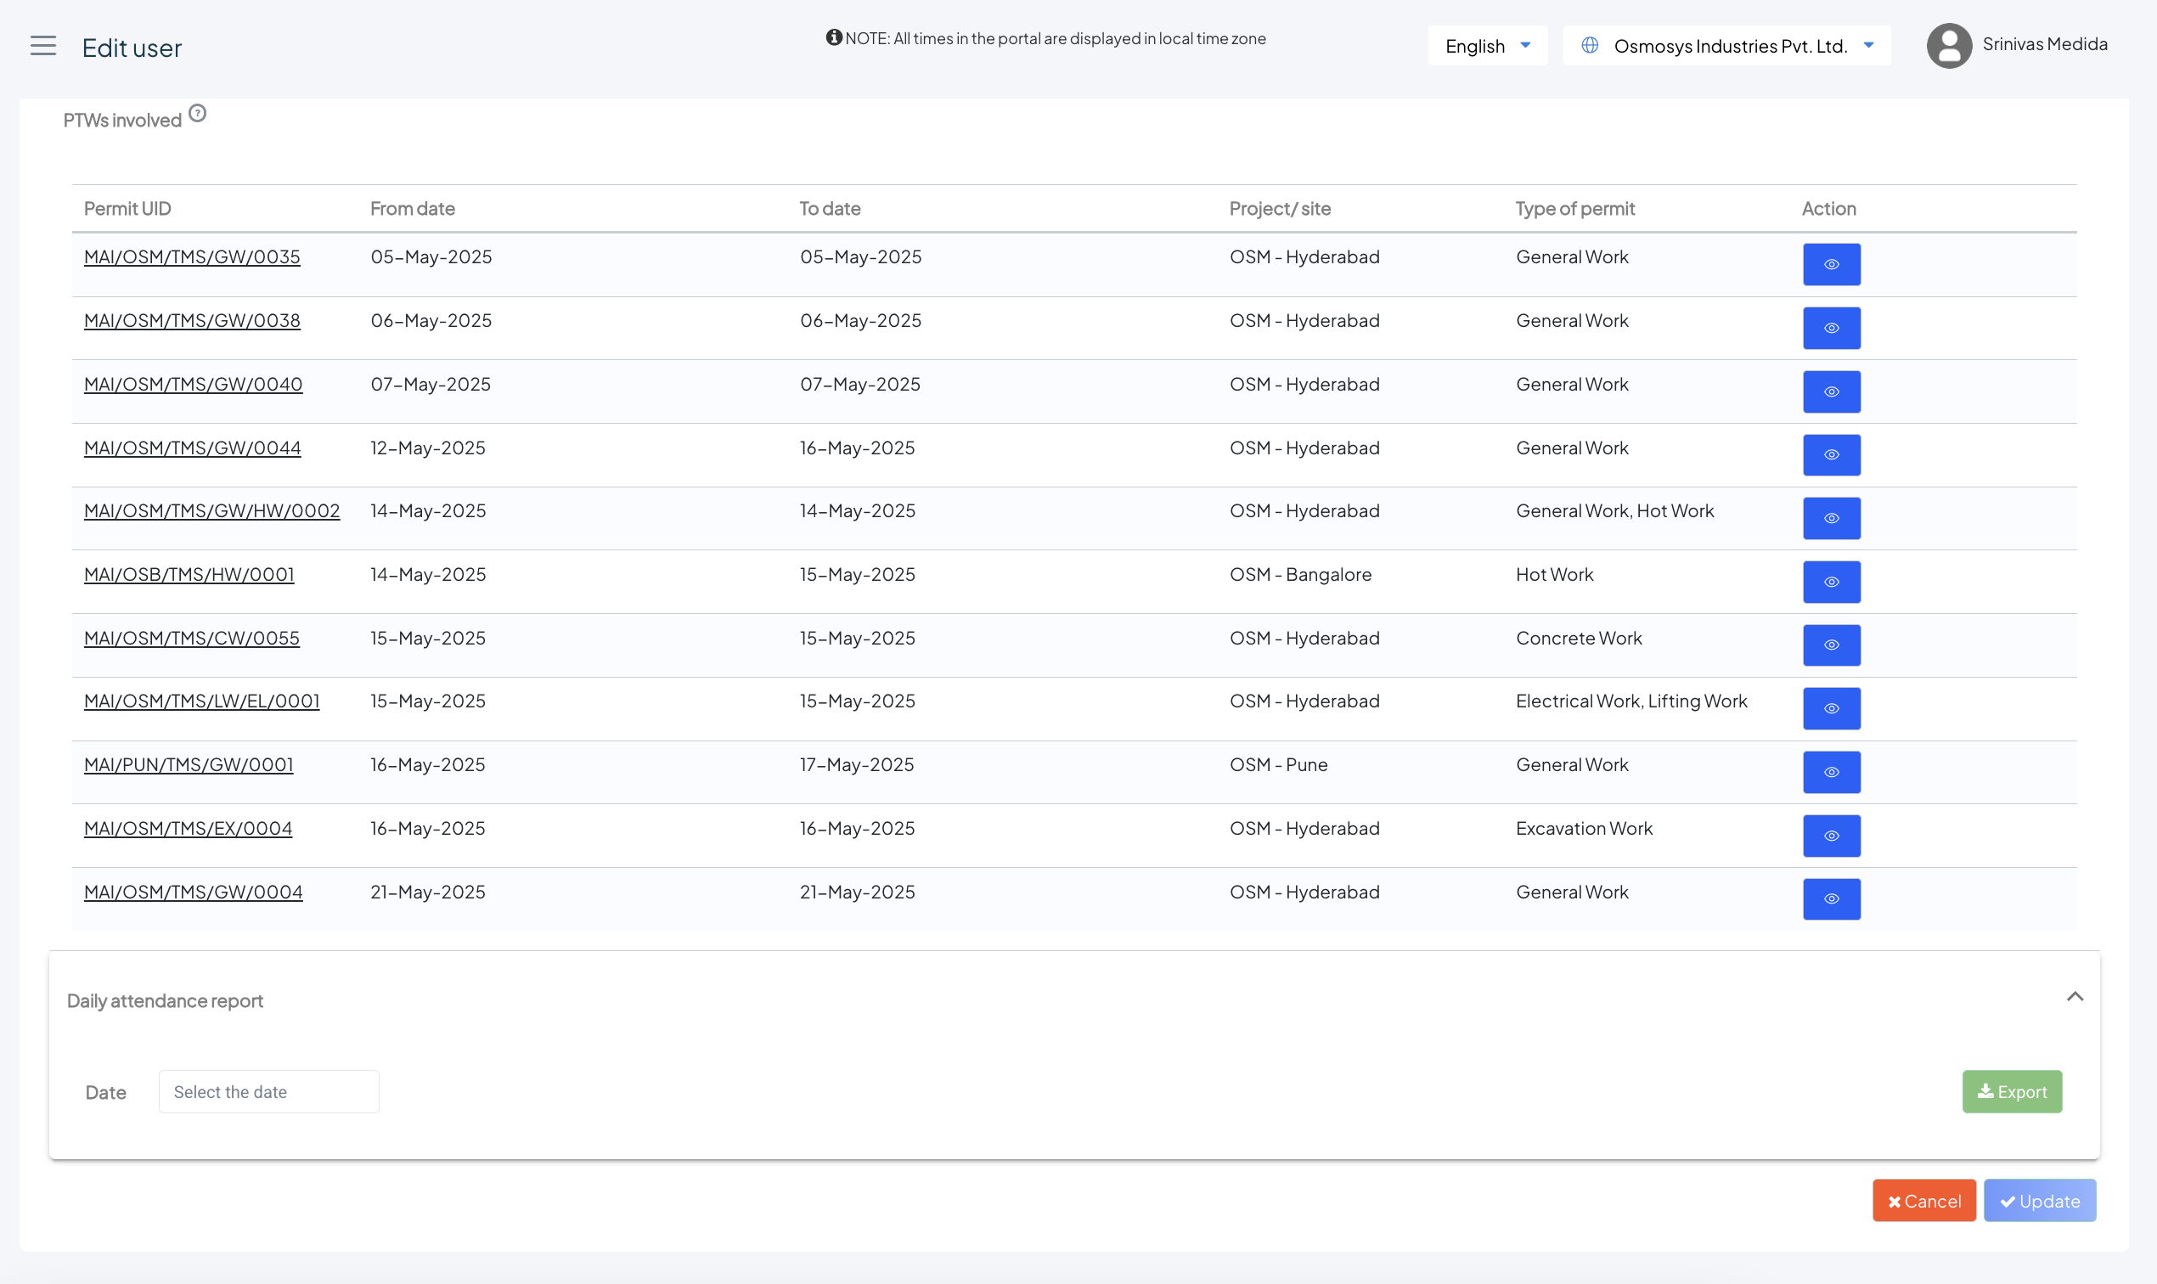
There are too many fields here
I tried very hard to fill all details
But the update button is still gray
Its better we let it be normal – and then show which is mandatory
And then randomly it became active

Slide 11
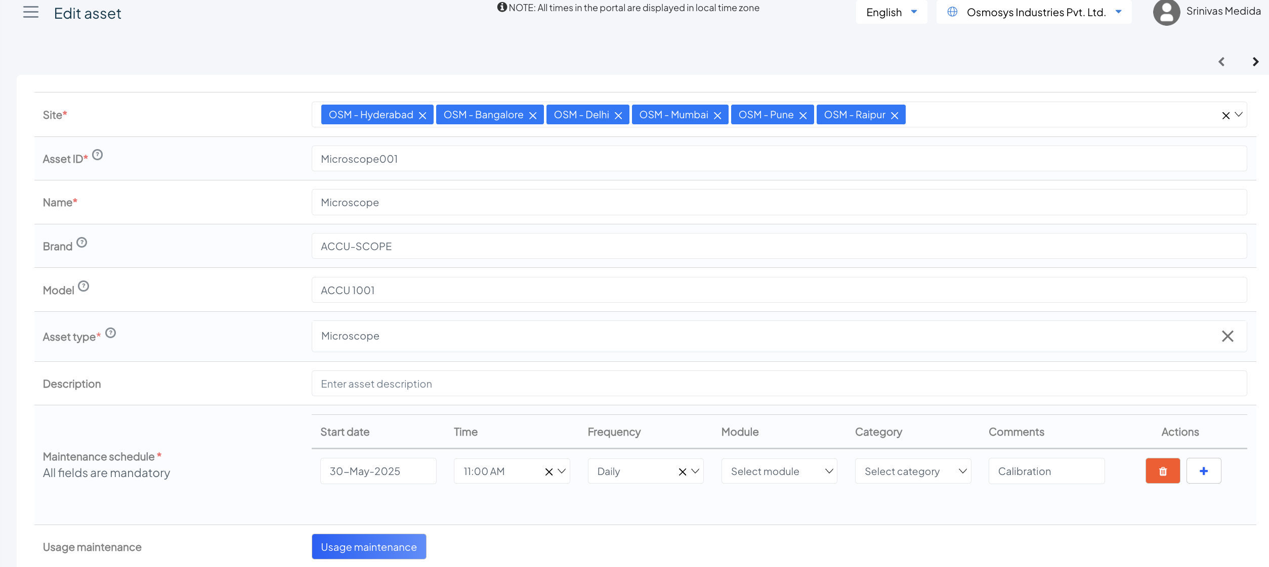
Everywhere else this plus sign is in green color – why is it white here?

Slide 12
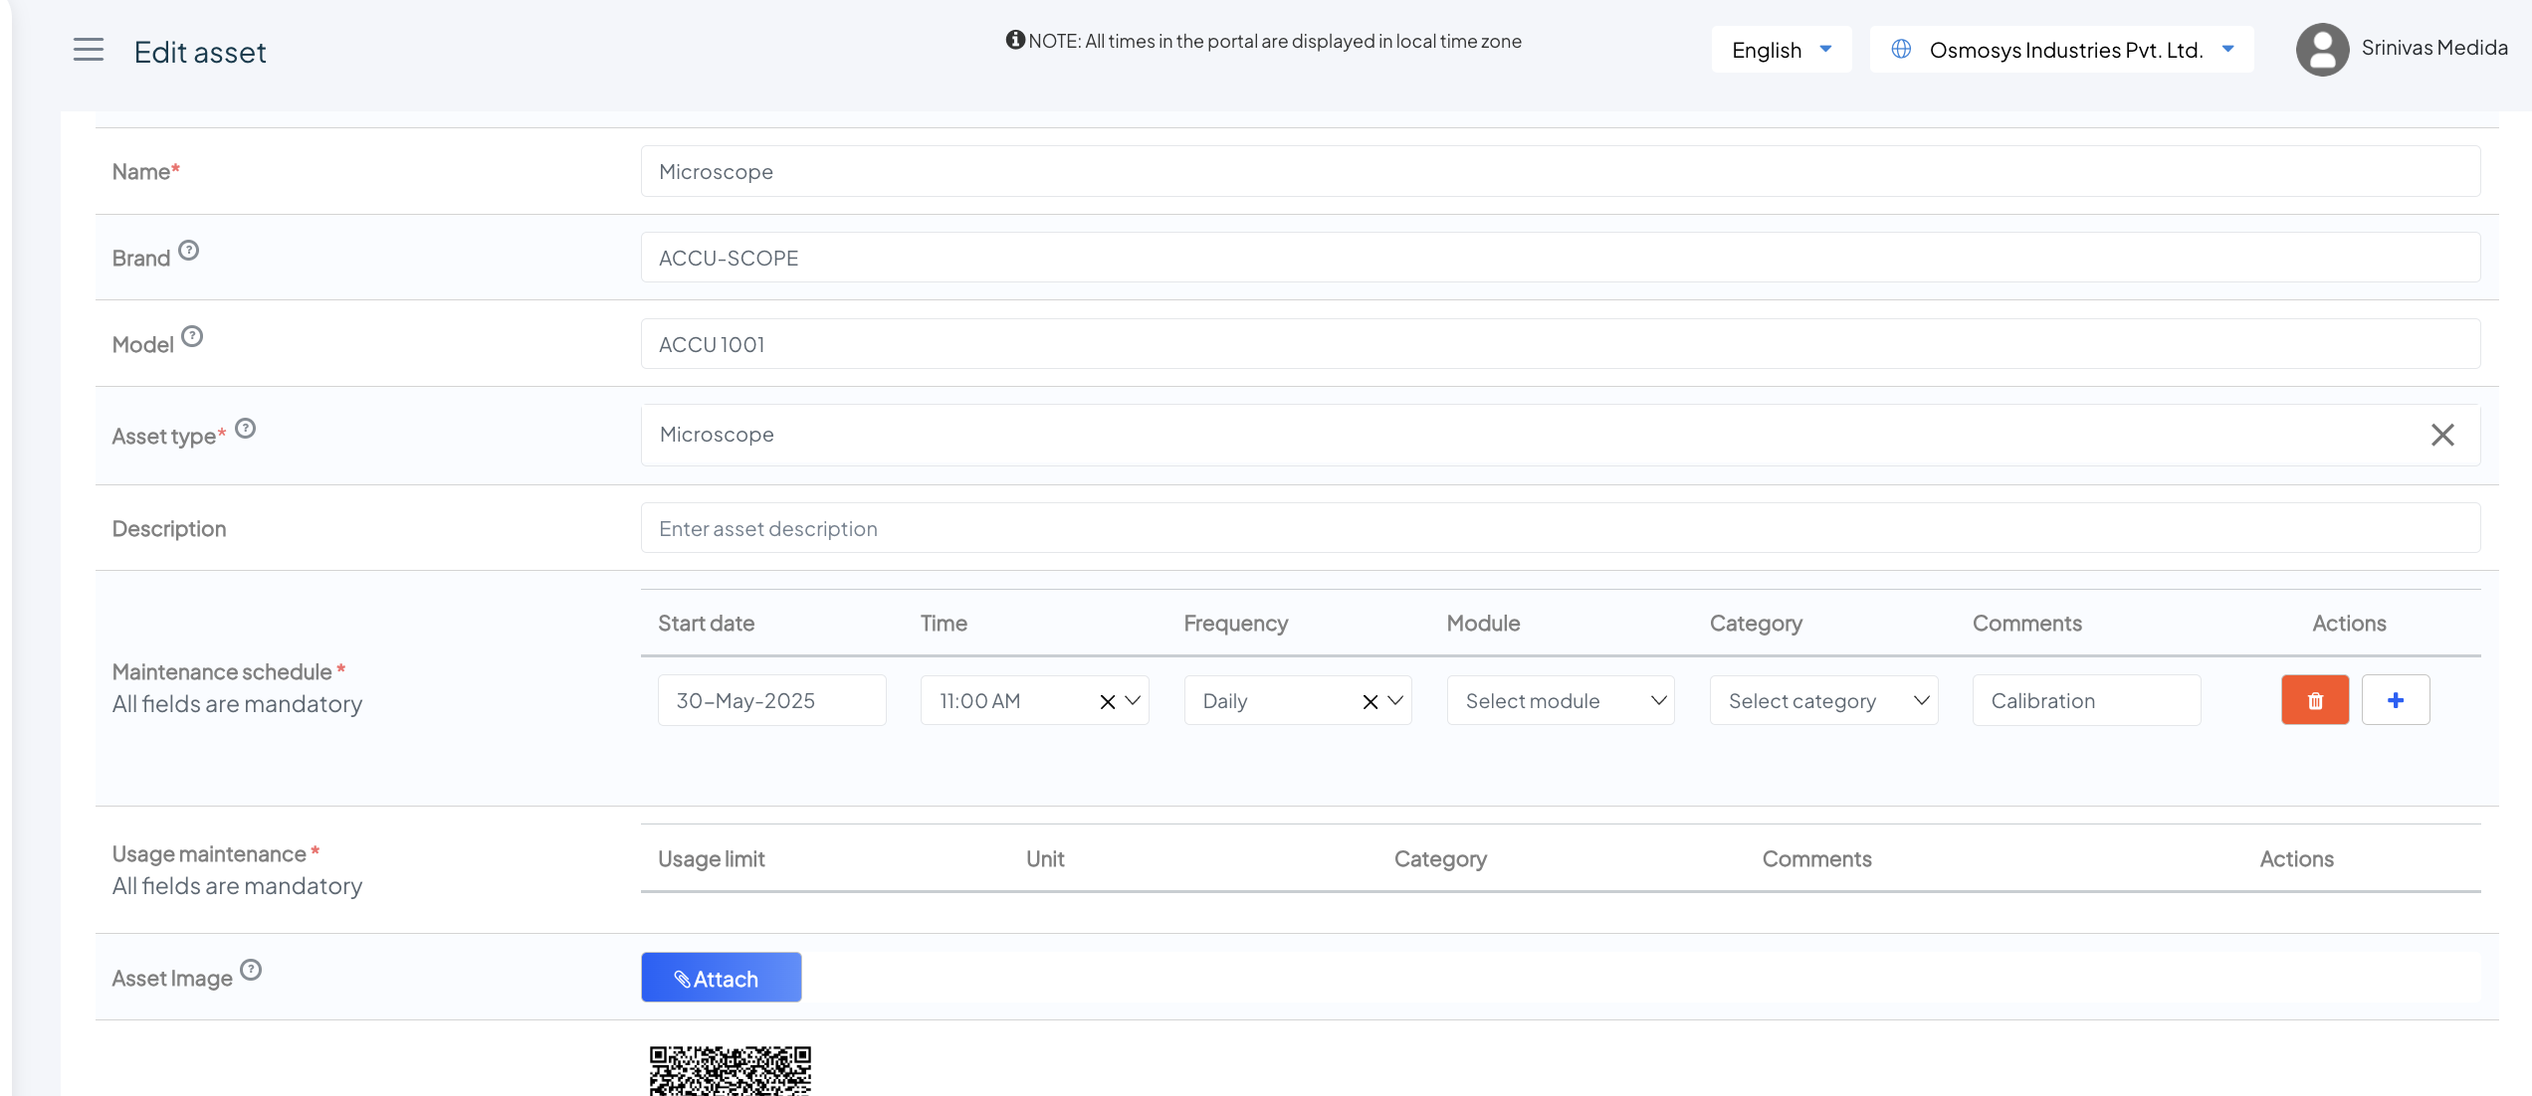
Usage maintenance is NOT working

Slide 13
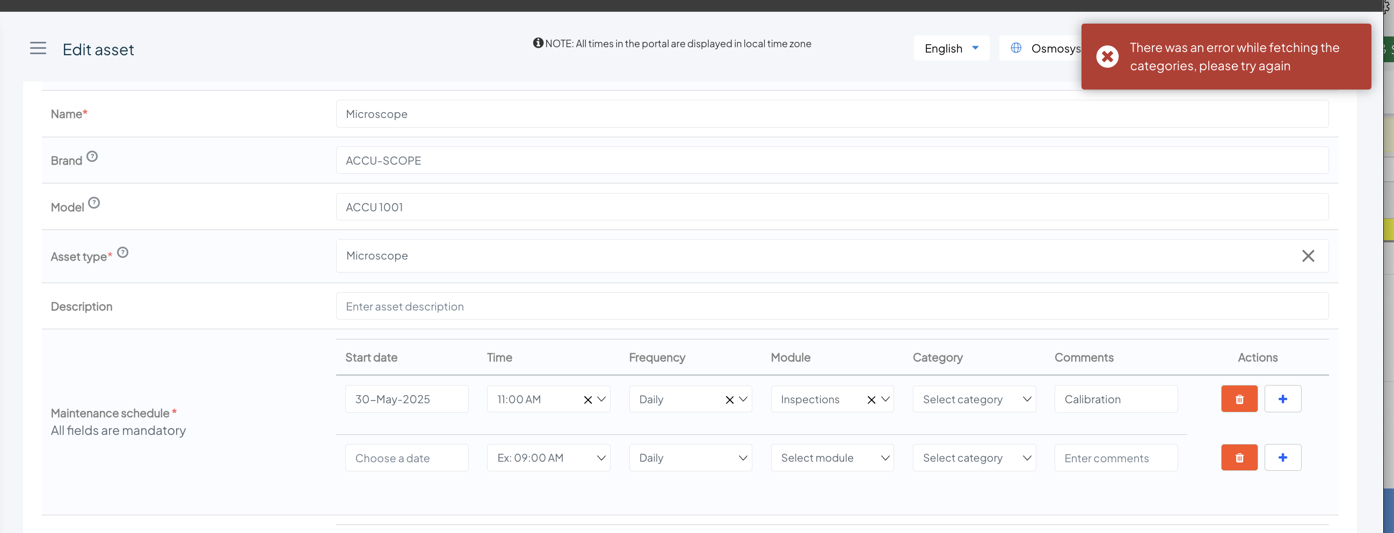
When I select inspections – this error is coming
This orgn
“osmosys industries”
Has no inspections module
I don’t see it I setup or in the menu
But it appears here

Slide 14
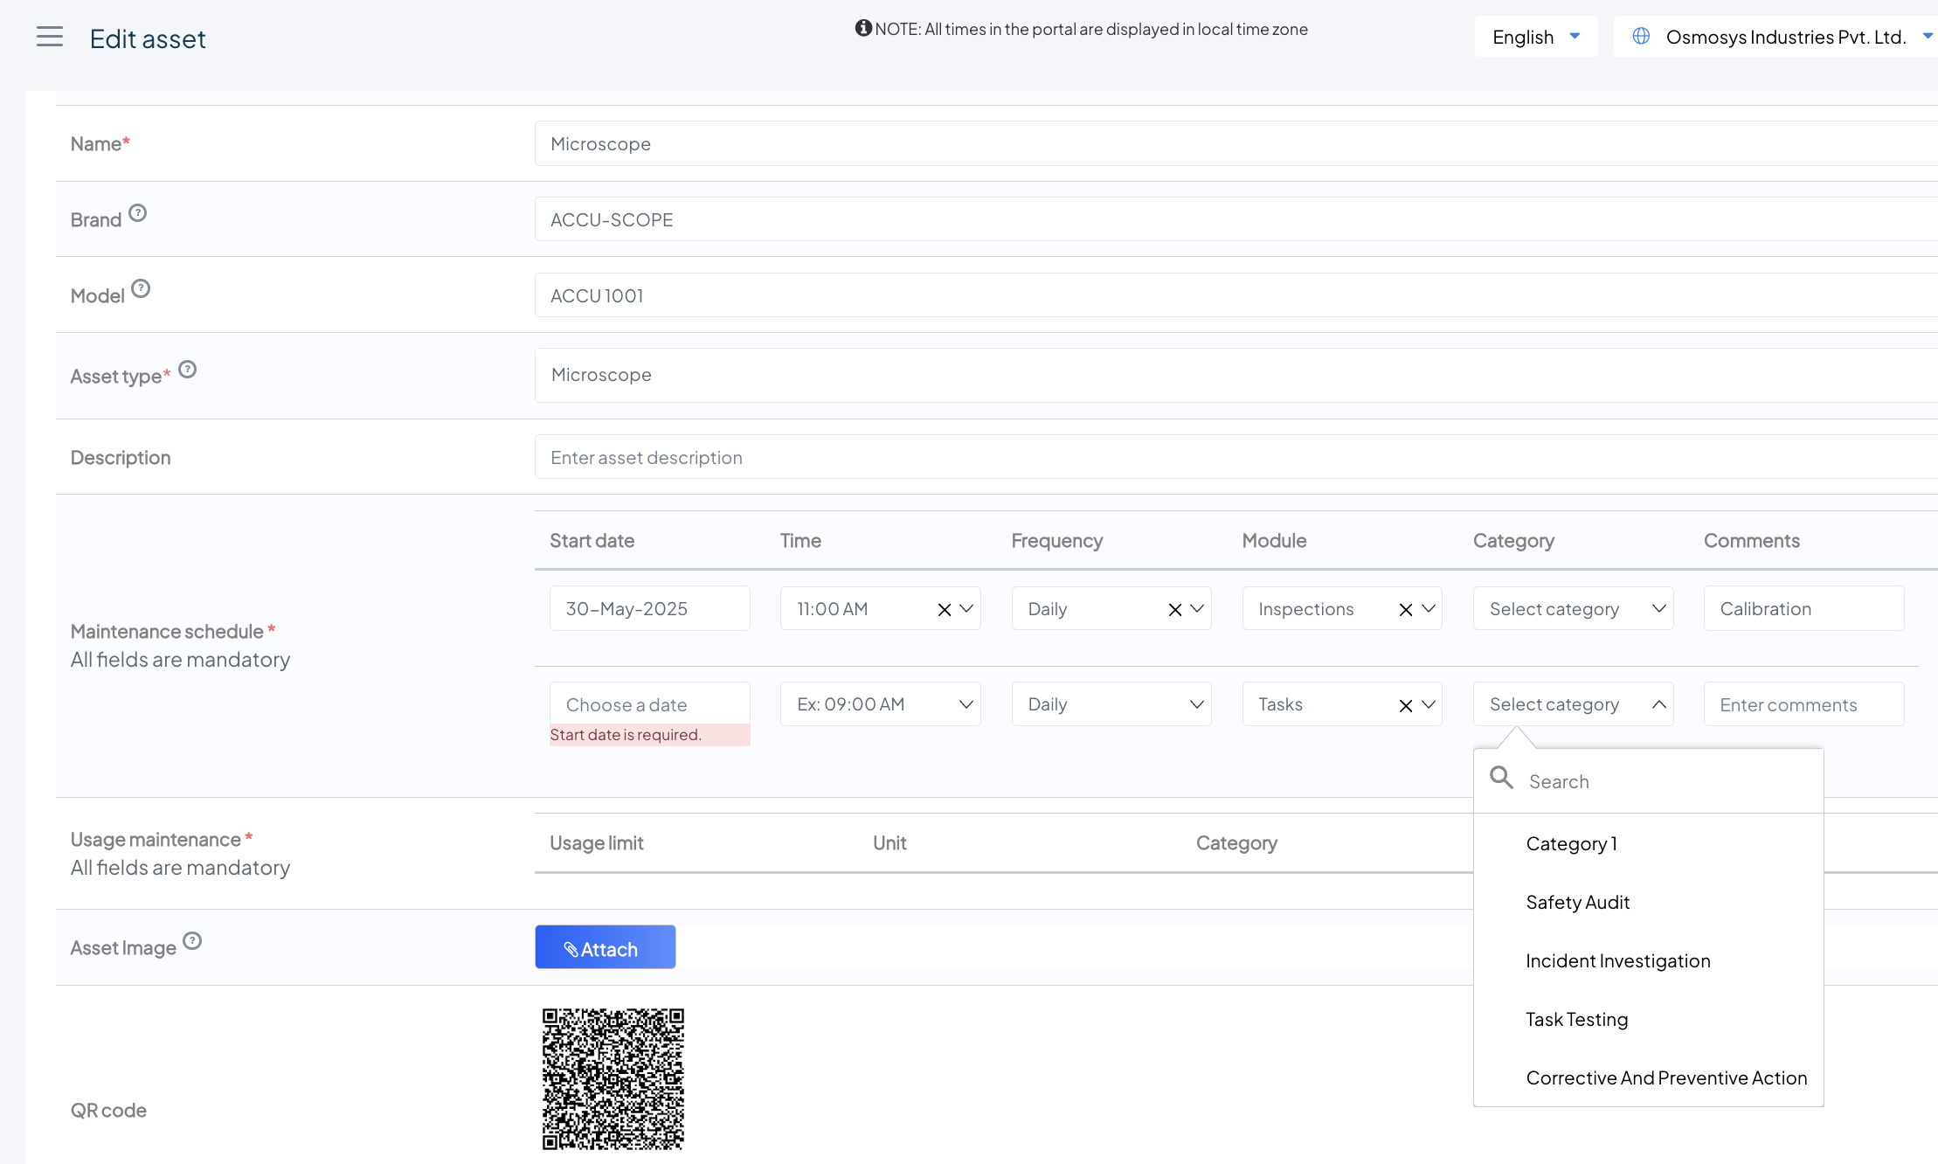
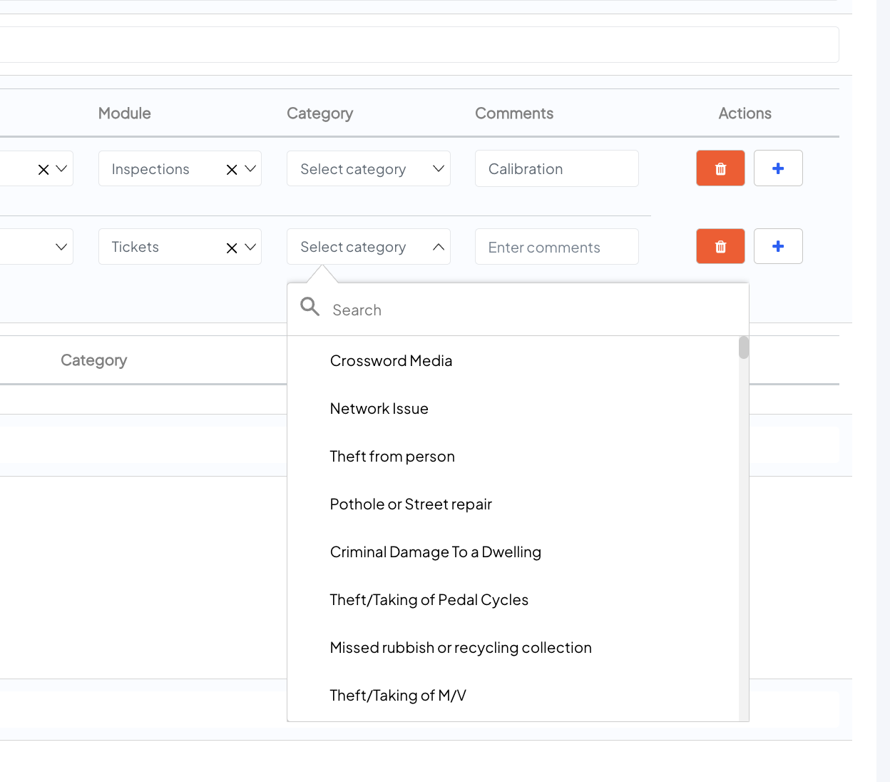
The task categories shown are NOT sorted alphabetically
Same with the ticket category

Slide 15
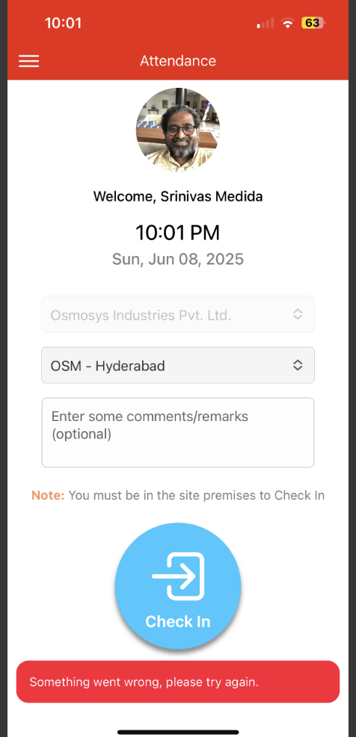

Slide 16
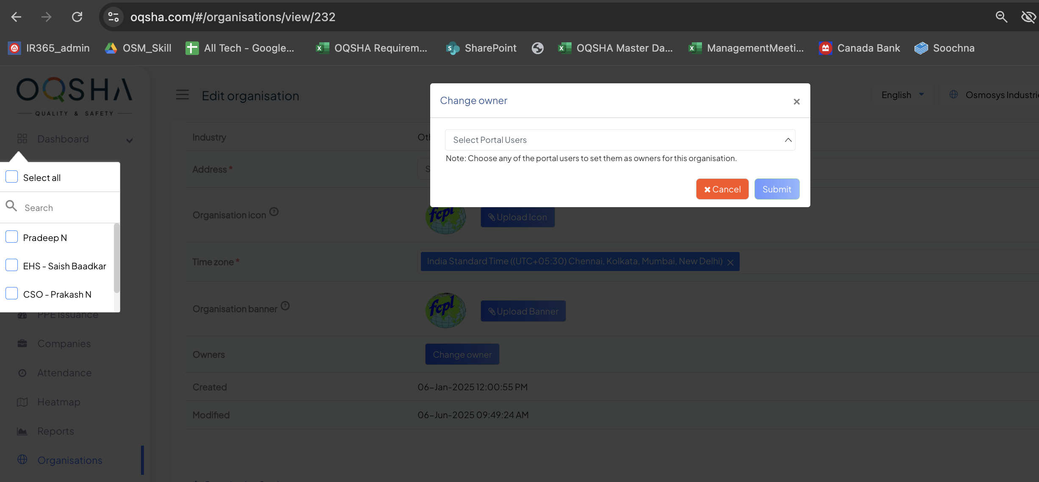
Look at the positioning?
AND WHERE is this list brought from?
These names are NOT from this organisation

Slide 17
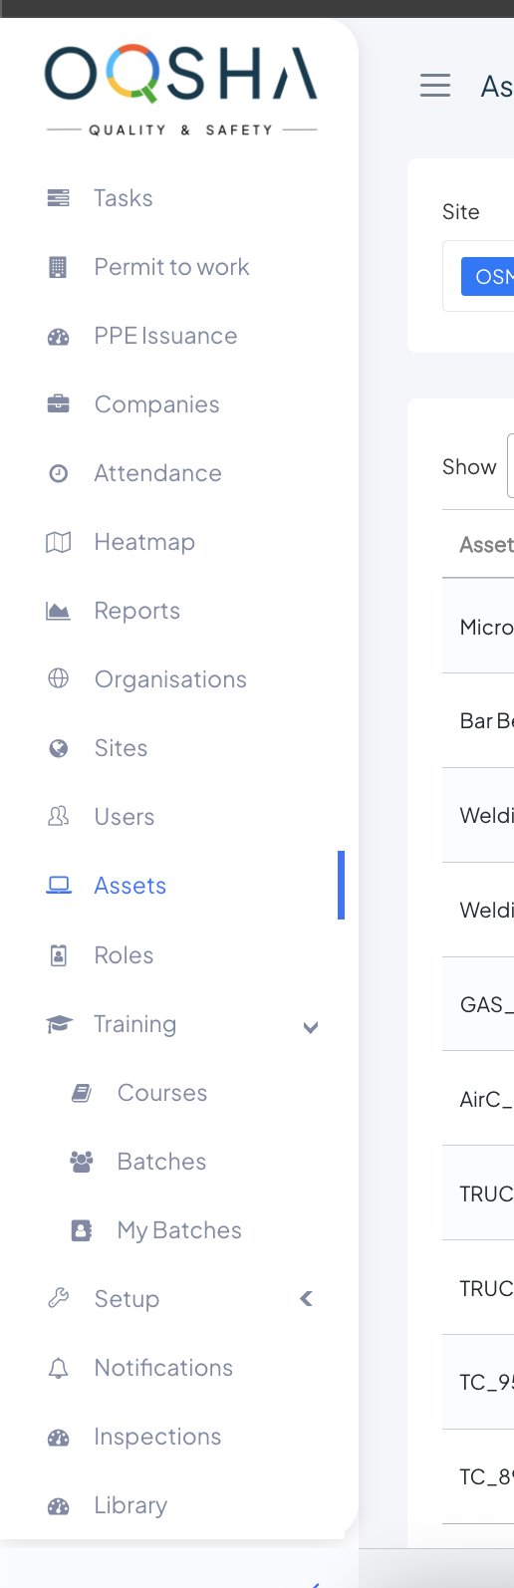
I see inspections & library in the menu
But they don’t response

Slide 18
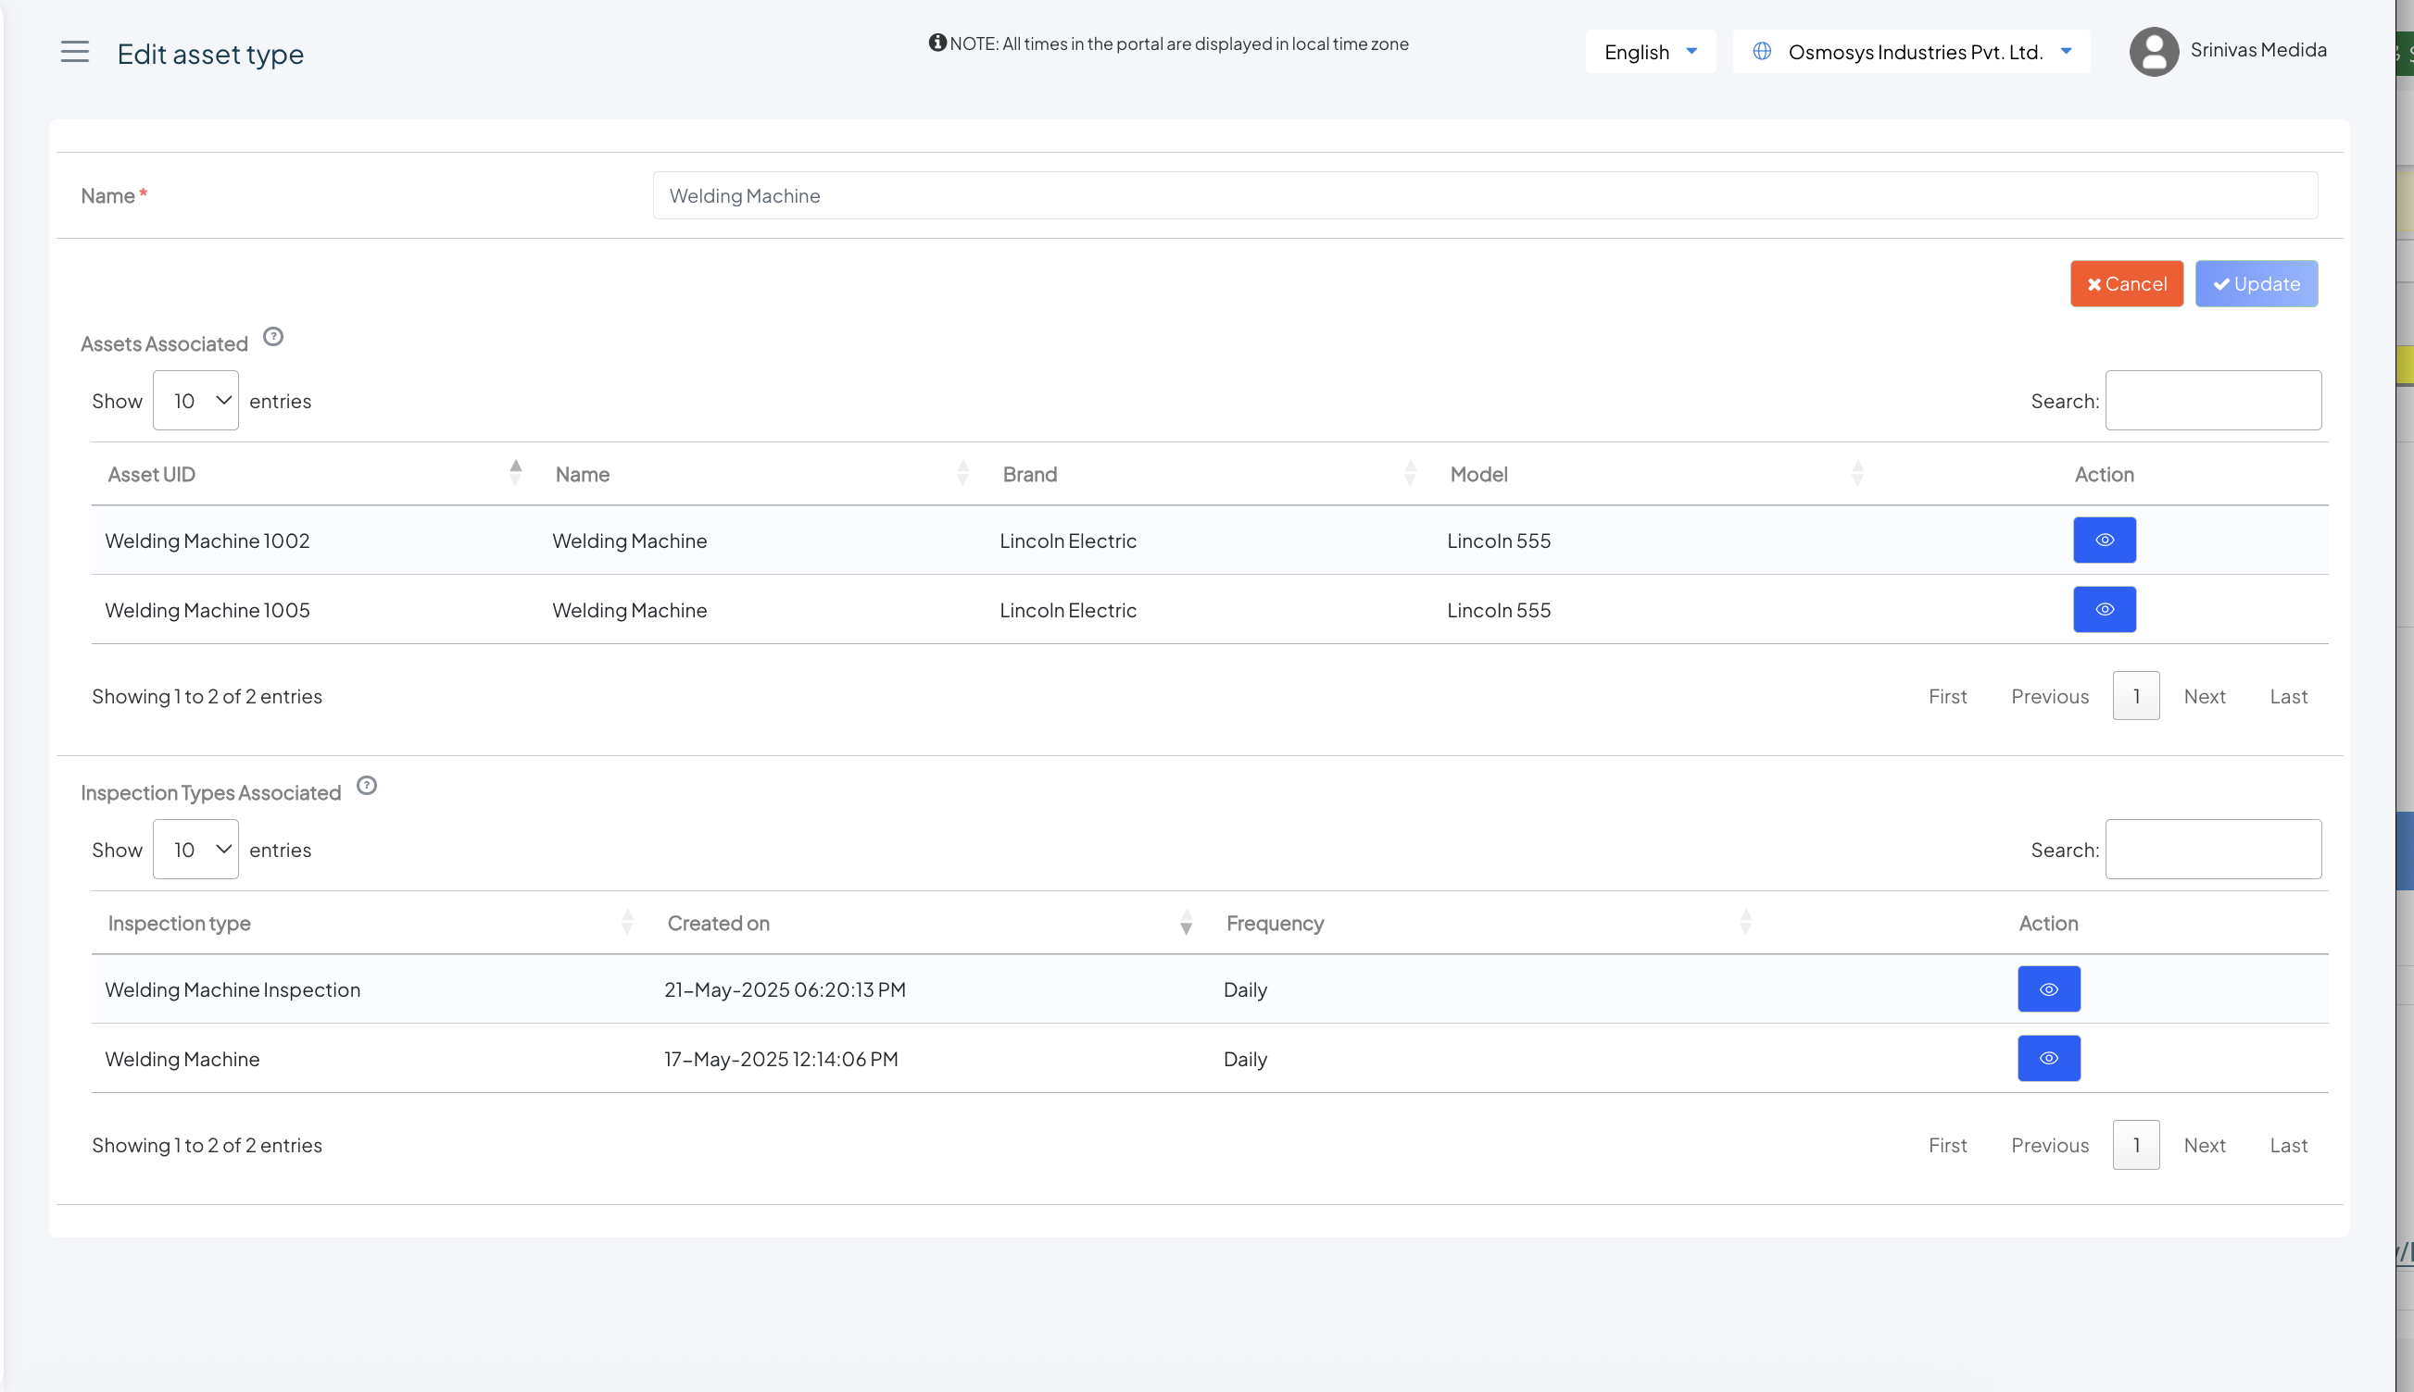
For each of these grids – can we have minimize buttons like we have in site page

Slide 19
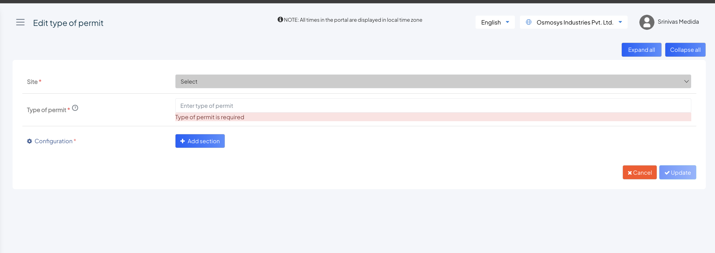
When I select an existing PTW setup record – this is how it appears

Slide 20
