Slide 1
IR → OQSHA
changes

Slide 2
Change the IR365 name
Change website

Slide 3
Change Incident word
We need to change the word “Incident” to something else “Tickets / Issues” – may be we can make this word as configurable in the Orgn level
Since we are handling quality & training, the incident types will have be renamed; Lets call this “Categories(Electrical / security)”
Under category – we will have a Type with (Incident, near miss, Observation, Quality issue, absence) – allow them to add / modify new ones
So if a category has only ONE type, then in the APP, we do not show the type selection; Otherwise we have to show the type selection.
We already have Incident type(Category) permissions for individuals; should it go down to Type level – we will come back to it later

Slide 4
Main Menu
Change “Incidents” to ”Tickets” – read it from Organisation and make it dynamic

Slide 5
Portal -> Incidents page list view
Rename Incidents title as “Tickets” – read from organisation
Change Filter ”Incident Type” to ”Category” – we can read this name dynamically for IR Admin so each company can have a different name
In the list view filters, we need to add “Type” this data comes from setup based on Category
Change the “Add Incident” button to “New Ticket” (Dynamic word)

Slide 6
Portal -> Add incident page
Change label “Incident type” to ”Category”
Change “Incident Date & Time” to “Ticket Date & Time” (Word to be dynamic)
In the Portal->Incident reporting page, we need to add ”Type” to be selected based on the category

Slide 7
Portal -> Edit Incident
Label “IR Users” to change to “Oqsha Users”
Label “Incident UID” to change to “Ticket UID” –Dynamic)
Label “Incident Type” to change to “Category”
Label “Incident Images” to change to “Images”
Label “Incident Videos” to change to “Videos”
Label “Incident Audios” to change to “Audios”
Label “Incident Date & Time” to change to “Date & Time”
Label “Incident Status” to change to “Ticket Status” Dynamic
Label “ Show comments for similar incidents” – change to “Show comments for similar Tickets”

Slide 8
Portal -> Heatmap
Label “Incident Type” to change to “Categories”
Add a new filter “Type” based on Catergory
More incident words when we click on a particular marker pin

Slide 9
Portal -> Organisations
Change label “Allow incident Resolution only if assigned” to “Allow Resolution only if assigned”
Change Label “Allow incident assignment while reporting” to “Assign while reporting ?”
Change Label “Closed Incident Status” to “Closed Status?”
In the geofencing section, change the following text “Create a virtual geographic boundary which enables you to control whom your organisation is visible to and who can report incidents under your organisation.” to “ Create a virtual geographic boundary to control reporting area”

Slide 10
Portal -> Sites
In the geofencing section, change the following text “Create a virtual geographic boundary which enables you to control whom your organisation is visible to and who can report incidents under your organisation.” to “ Create a virtual geographic boundary to control reporting area”

Slide 11
Portal -> Users
Change label “Show all incidents in Feed” to “Show all tickets in feed” (Tickets should be dynamic)

Slide 12
Portal -> Assets (list view, add, edit)
Change Label in Grid “ Incidents involved in” to “Associated with”

Slide 13
Portal -> Setup List view
Change column title “Incident Type” to ”Category”
Change button “ Add Incident Type” to “New Category”

Slide 14
Portal -> Setup -> Add incident type
Change Label “Incident Type” to ”Category”
In the comment in Checklist (While reporting an incident, these questions will be asked) – Change that to “While reporting, these questions will be asked”
Change Label “Incident Type Settings ” to ”Settings”
Change Label “Allow similar incident detection” to ” Allow similar tickets” Dynamic
Add a new “Type” under the Category. This should be a dropdown to select existing types and associate them with a category. We should also allow addition of new types here
Allow multiselect of these types – so for one category, multiple types, all escalation details etc will be same.\

Slide 15
Portal -> Setup -> Add incident type
Category = Electrical
type= Incident → Escalate to MS
Checklist questions 1,2,3
Category = Electrical
Type = observation/near miss/quality --> escalate to RAJ /Sindhu
Checklist questions 2,3,7

Slide 16
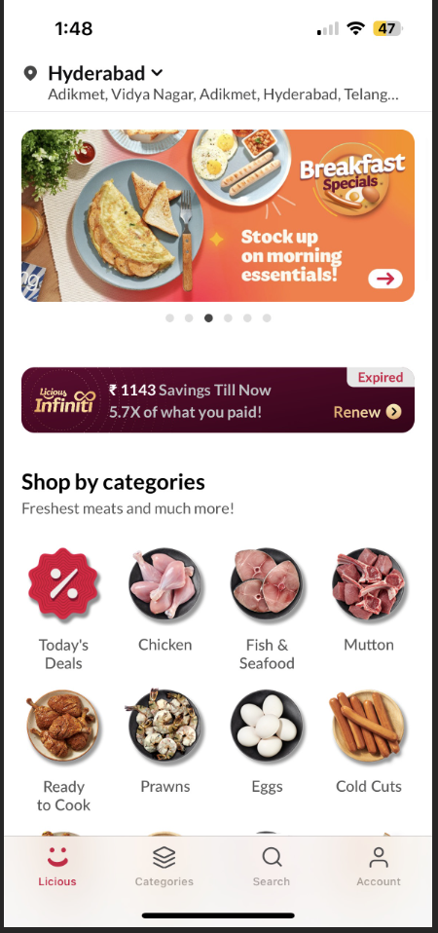
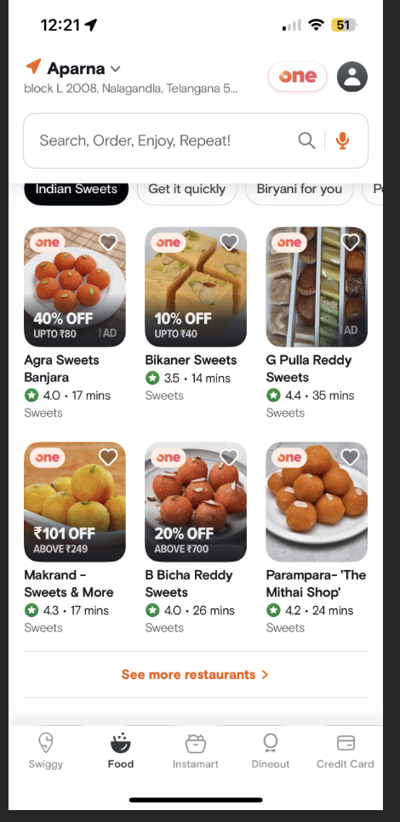
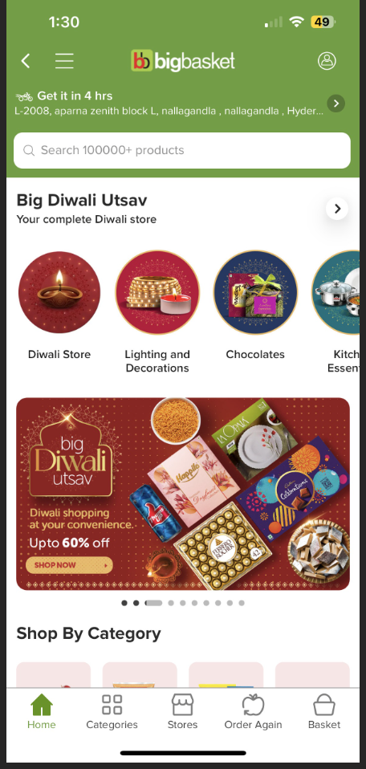
App - redesign
We could make this as one way to show feed; show the image and some text.

Slide 17
Map
We make the app long
As we scroll it goes down
Swiggy has sections that allow horizontal scrolling of “sections”
The feed can also be nice images
Expand
ORGANISATIONS
Expand
New
Past
Feed
Expand
Notifications
Expand

Slide 18
App -> Name & logo change
Menu->report incident ; change to “Report Now”
Menu->Incidents reported ; Do we need this? If we need, we should change it to “My reporting”
How much dynamic can we make them based on organization – someone might want to make it “New ticket”

Slide 19
App -> Report incident page
Menu->report incident ; change to “Report Now”
Menu->Incidents reported ; Do we need this? If we need, we should change it to “My reporting”

