Slide 1


OQSHA_MOC
@reportwithoqsha
www.oqsha.com
@2025 |Confidential

Slide 2
Background
Management of Change (MoC) is a critical safety process used to manage risks associated with changes in operations, equipment, or personnel in industrial and high-risk environments. Here are 10 concise lines explaining the concept:
Management of Change (MoC) is a formal process to evaluate and control safety, health, and environmental risks before implementing changes.
It ensures that modifications—whether temporary or permanent—do not introduce new hazards or compromise existing safeguards.
MoC typically applies to changes in equipment, processes, materials, technology, and personnel roles.
The process involves risk assessment, documentation, approval, communication, and training prior to executing the change.
It is widely used in industries like oil & gas, chemical, manufacturing, and utilities to prevent incidents due to uncontrolled changes.
MoC requires multidisciplinary review to evaluate the impact of change on safety systems, procedures, and regulatory compliance.
A robust MoC system helps in identifying potential failure points early and mitigating them proactively.
It promotes accountability by assigning responsibilities for reviewing and approving proposed changes.
MoC also ensures updated documentation, such as P&IDs, SOPs, and emergency response plans, reflects the change.
Ultimately, MoC enhances operational reliability and prevents accidents caused by unassessed or poorly implemented changes.
@reportwithoqsha
www.oqsha.com
@2025 |Confidential

Slide 3
Things to look for
This will have forward and authorisation
Will also include comments by people reviewing the document
Upload of one or more documents
This module is connected to PSSR module so record connection will be there
@reportwithoqsha
www.oqsha.com
@2025 |Confidential

Slide 4
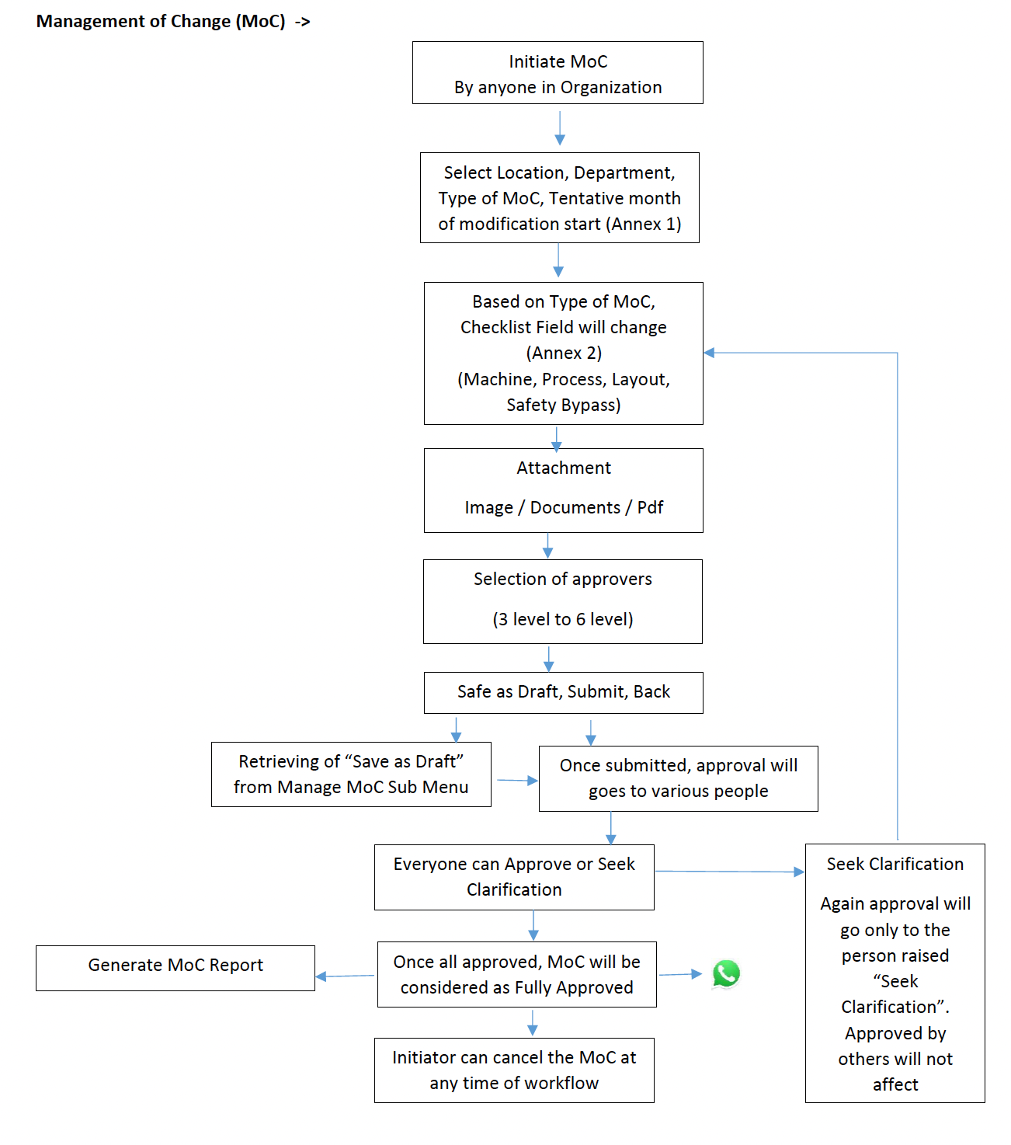
TTK Requirement

Slide 5
MOC – List page
Filters
Initiated by
Type of MOC
Department
Start date
End date
Status
The grid to show the following data
Initiated by
Type of MOC
Department
Start date
Status
View option for each record
Delete option with a confirmation (if deleted, but the status is pending approval, shall we send alerts to people who were earlier sent alert asking for approval)
@reportwithoqsha
www.oqsha.com
@2025 |Confidential

Slide 6
MOC – Add page
Initiated by – auto populate the user
Created at - Auto populate date & time
Location : text field (this could be any location in a site therefore I am saying text field)
Department : dropdown
Type of MOC : Dropdown
Checklist : these may be like questions – based on the MOC type
File attachments – Multiple files (same restrictions as any file upload)
Approvers : Dropdown – multiselect ( need to know what kind of people are to be listed here)
Status : Draft / Submit / Back (don’t know what back is – we shall name it Clarify) / Approved (when everyone approves, we can set it to approved; Cancel option – If done, all approvers to be informed)
Submit : once this button is clicked – email / whatsapp shall go to the people selected as approvers.
Comments : Since each of the approver can leave comments, we need something like Ticket comments here – showing who / when / what is said (even if approved, we need to mention that)
Can we copy paste ticket module and make modifications? And opportunity to make it JSON based
It has category & checklist setup
It has multiple assignment
It has alerts
It has comments
@reportwithoqsha
www.oqsha.com
@2025 |Confidential

Slide 7
MOC – Edit page (edit can be by the initiator or even the approver)
Initiated by – auto populate the user
Created at - Auto populate date & time
Location : text field (this could be any location in a site therefore I am saying text field)
Department : dropdown
Type of MOC : Dropdown
Checklist : these may be like questions – based on the MOC type
File attachments – Multiple files (same restrictions as any file upload)
Approvers : Dropdown – multiselect ( need to know what kind of people are to be listed here)
Status : Draft / Submit / Back (don’t know what back is – we shall name it Clarify) / Approved (when everyone approves, we can set it to approved; Cancel option – If done, all approvers to be informed)
Submit : once this button is clicked – email / whatsapp shall go to the people selected as approvers.
Comments : Since each of the approver can leave comments, we need something like Ticket comments here – showing who / when / what is said (even if approved, we need to mention that)
This checklist – I would assume this is like our tickets checklist. So we need a setup page for category & checklist.
All fields can be modified by the Initiator except date & initiated by
For approvers – we need to allow a “Comments” field, and have two buttons “Approve” “Clarify” – in both cases, the initiator shall get alert
@reportwithoqsha
www.oqsha.com
@2025 |Confidential

Slide 8
+-----------------------------------------------------------------------+
| LOGO MANAGEMENT OF CHANGE (MOC) REQUEST [Draft]|
+-----------------------------------------------------------------------+
| Initiated by: [John Doe (john@company.com)] (disabled) |
| Created at: [30-Apr-2025 14:30 GMT] (disabled) |
+-----------------------------------------------------------------------+
| Location: [________________________] (free-text, e.g., "Site A") |
| Department: [▼ Engineering ▾] (dropdown) |
| Type of MOC: [▼ Equipment Change ▾] (dropdown, triggers checklist) |
+-----------------------------------------------------------------------+
=== DYNAMIC CHECKLIST (example for "Equipment Change") ===
[✓] Has risk assessment been completed? (☑ Yes / ☐ No)
[✓] Attach safety certification: [📎 Upload File]
[✓] Additional notes: [________________________]
+-----------------------------------------------------------------------+
=== ATTACHMENTS ===
[📎 Drag & drop files here (max 10, 5MB each)]
Uploaded:
- Risk_Assessment.pdf [🗑️]
- Photo.jpg [🗑️]
+-----------------------------------------------------------------------+
=== APPROVERS ===
[▼ Select Approvers ▾] (multi-select dropdown with search)
Selected:
- Safety Officer (Jane Smith)
- Site Manager (Alex Brown)
+-----------------------------------------------------------------------+
=== COMMENTS & HISTORY ===
[Timeline view - newest first]
1. 01-May-2025 10:00 - Jane Smith (Safety Officer): "Need updated risk doc."
2. 30-Apr-2025 14:30 - Draft created by John Doe.
[Add Comment]: [________________________] [Post]
+-----------------------------------------------------------------------+
=== ACTION BUTTONS ===
[Save Draft] [Submit] [Cancel] [Clarify]
(Submit triggers email/WhatsApp to approvers; Cancel asks for confirmation)
+-----------------------------------------------------------------------+
Where will the department come from? Can we take out of users? Or shall we add departments in “ organization page”
These dynamic checklist will have to come based on Type of MOC>
This list has to come from users – who are approvers – yet to decide that logic
Are these comments going to a common table or are we making it for each entity

Slide 9
MOC – things to look for
Once everyone approves, we shall freeze the record and not allow editing
But if editing for any reason, we shall give a warning “ that the approval will be cancelled and status goes back to draft”
When someone seeks clarification - > the initiator gets an alert – the initiator can make changes, write comments and that alert then should go ONLY to that approver seeking clarifications
We need a way to identify who have to be shown in the approvers dropdown. This may change based on the department also
@reportwithoqsha
www.oqsha.com
@2025 |Confidential

