Slide 1








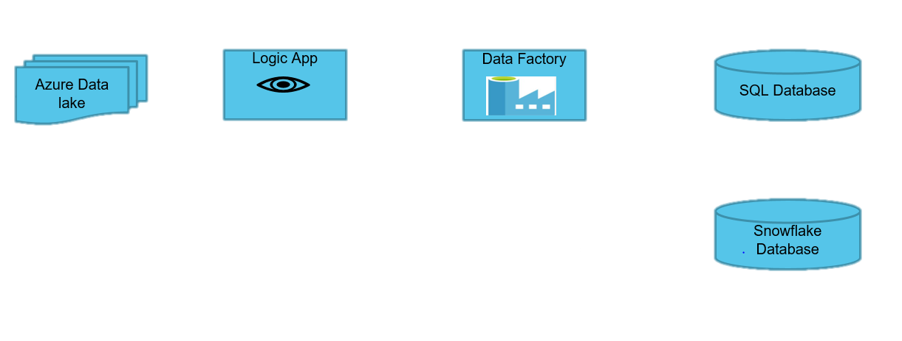







PROJECT ON FINANCIAL SERVICES ETL TOOL
SEMESTER INTERNSHIP 2022
Final Year, Bennett University, Greater Noida, India
Muskan Garg-E19CSE185
Dept. of Computer Science Engineering, Bennett University, India
Crowe is a public accounting, consulting, and technology firm that combines deep industry and specialized expertise with innovation.
SERVICES
Audit
Tax
Advisory
Consulting
My position :
Data Services Intern
Under the guidance of:
Jitendra Rana
(Data Services Architect
Manager)
About Data Services :
Data services provides technical expertise in SAP development, analyze requirements & evaluate technology options to address business processes and improve system efficiency. A data services developer has in-depth knowledge in software development life cycle, data analysis (Tableau or Power BI), business analysis, data validation.
TOOLS AND TECHNOLOGIES
Work experience
Data Analytics
Azure
SQL Server
Management
Studio
AUGUST
Training
Crowe University trainings, technical trainings on SQL, Power BI and Azure.
SEPT - OCT
Project
Worked on live project under the project leaders.
NOVEMBER
Feedback
Received a positive feedback from the manager. Assigned another live project.
CHALLENGES AND LEARNINGS
How to create a database project
Making SQL queries for testing
Creating data entities
How to run pipelines in azure
Inter - personal skills
Managerial skills
Time management
Task management
Giving a self check to my own performance.
Developed a habit of giving reviews on time.

