Slide 1
IR Changes

Slide 2
Add course
Table showing existing Courses. Allow editing & Deleting(With confirmation)
Course name : Date Updated : Duration : Number of people completed

Slide 3

Add course
Course Name
Description
Course Certification
Course Duration
Hours / days / weeks
Course Content
(Make this section expandable)
Module Name
File / Link
Duration
Module Name
File / Link
Duration
+
Course Batches
(Make this section expandable)
Batch ID
Date
Status
Add Batch
Batch ID
Date
Status

Slide 4
Batches List
Course Name
Dropdown
Add Batch
Course Batches
(Make this section expandable)
Batch ID
Date
No of Registrations
Status
E
Batch ID
Date
No of Registrations
Status
E is for Edit button
Delete needs confirmation

Slide 5
Add Batch
Course Name
Dropdown
Batch ID
String
Starting Date
Date
Participants
User First Name
User Last Name
User First Name
User Last Name
+

Slide 6
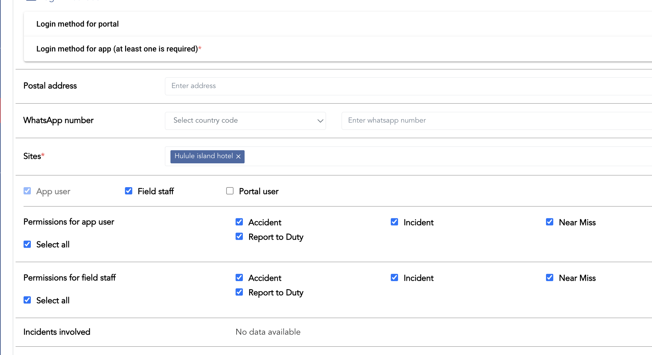
In this page, we shall add the courses this person completed including batch ID / Date
And we shall have a button here (Register to a course) – that allows to add this person to a new batch of a course.

Slide 7
On the Mobile side
Add a menu item – Trainings
Show the courses taken / completed
Show the current courses registered to
Give access to the content of that courses
If a person is added to a batch – then get whatsapp Notification
On the day / prior day of the batch starting – send notification

Slide 8
New mobile Menu
Google map
We need to have dynamically adjustable
If we don’t need trainings, don’t show it
No appointment – don’t show it
Also – suppose we name this as a “Attendance” – then that button should open Incident Reporting – with attendance as the incident type – and capture the geolocation
Raise Incident
Feed
Attendance
appointment

Slide 9
New mobile Menu
Google map
We need to have dynamically adjustable
If we don’t need trainings, don’t show it
No appointment – don’t show it
Also – suppose we name this as a “Attendance” – then that button should open Incident Reporting – with attendance as the incident type – and capture the geolocation
Raise Incident
Feed(s)
Attendance
Appointment

Slide 10
Web portal
We also should have a difffernt portal theme where we position the fields more tightly
And people can choose which option they want

